Slide 1
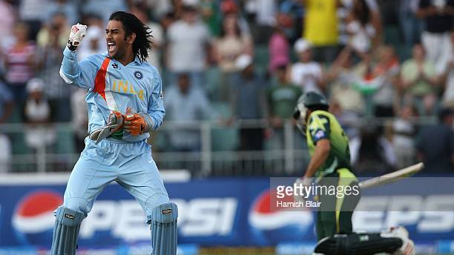
Comprehensive Cricket Analysis by devising a Relational DBMS
CSCI 5707

Slide 2
Team Members
Navanshu Khare (MS Data Science)
Shashank Magdi (MS Data Science)
Seetharam Reddy Ramireddy (MS Data Science)

Slide 3
Objective
Our objective is to create a relational DBMS using the concepts we learn from the class like constructing an ERD, pre-process the chosen data and implement some insightful Exploratory Data Analysis (EDA) and ultimately formulating desired user-oriented SQL queries that can effectively use the massive amounts of available data of Indian Premier League in the world to derive actionable insights.

Slide 4
Motivation
So, the question why Cricket?
And more importantly what is Cricket!?
Cricket is played between two teams of 11 players on each team. The matches are officiated by two on field and two off field umpires. Like Baseball, one team will bat while the other team takes the field. The sole aim is to score more runs than the opposition and you win! It’s that simple!
A 20 over game in the sport of cricket is such a volatile format where numbers and large volumes of data are often used to make key decisions right from acquiring players from an auction to acquiring local players to perform exceedingly well for their respective franchises and choosing prodigies to represent their respective countries.

Slide 5
Motivation
Key attributes like strike rate(how quickly one can score), player averages, win percentages as a captain / coach, most number of runs scored consistently, etc. can be used and represented initially in an ERD and then used to build a relational Database system to answer curious questions.
Many not so keen on eye statistics can be retrieved and talked about offering a different perspective on the player’s performance / importance to the respective teams.

Slide 6
Target Audience and users of the database
Ardent and inquisitive Cricket fans and fantasy team owners : No one wants to miss being in the thick of action!
Sports Analysts : To analyze and get key insights and offer invaluable inputs to team management.
Selection Panels and Franchise scouts : Understand trends and unearth prodigal talents.
Podcasts and Sports shows : Offer a visual treat to audience by unraveling the large messy data.
And of course, the players themselves!

Slide 7
Dataset
The Indian Premier League CSV Dataset from Kaggle has been used here, with extensive information comprising of player’s match’s metadata, most importantly ball by ball data of about 577 IPL matches played between 2008 - 2016 to give us enough data to work on!

Slide 8
Tools Used
Python
Microsoft SQL Server(MSSQL)
Jupyter Notebook
Dbeaver
MS Excel

Slide 9
Relationships Diagram
The dashed line means that foreign key column is not a primary key in a referencing table and the solid line means that the foreign key column is also a primary key in referencing table.

Slide 10
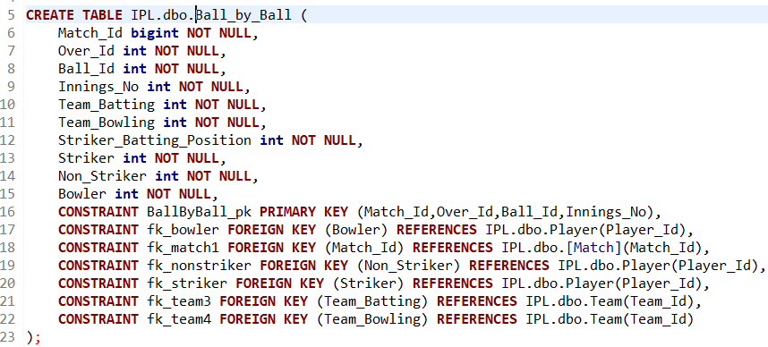
Defining the Tables

Slide 11
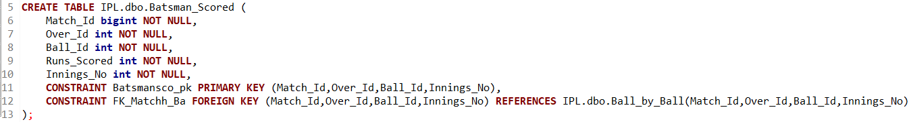
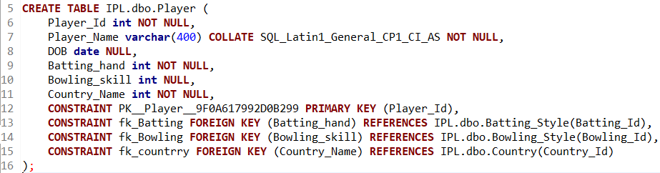
Defining the Tables

Slide 12
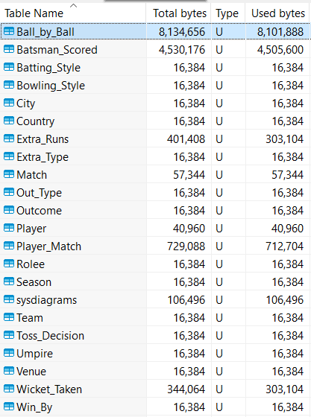
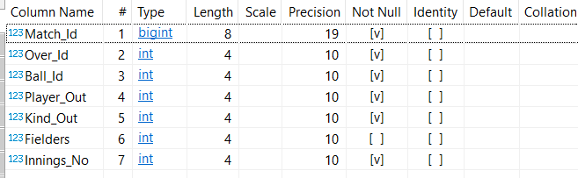
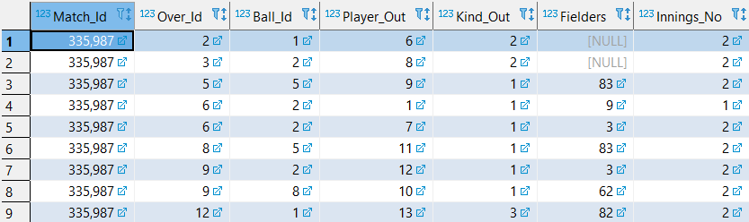
Mapping ERD to Tables
Relations list in our Database
Composition of “Ball by Ball” relation
Outlook of first few rows of “Ball by Ball” relation

Slide 13
Exploratory Data Analysis
A considerable amount of time was spent in the EDA part because we realized it was important to understand the data first before diving deep into organizing and writing queries data.

Slide 14
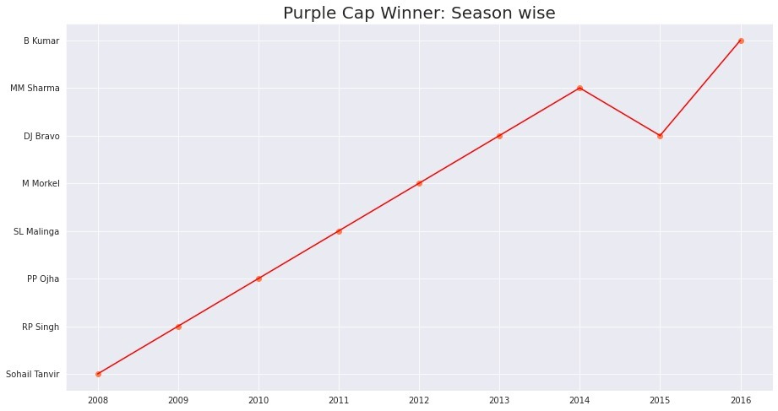
This graph displays the Purple Cap (given to player who picks most number of wickets in a season) winner of the IPL each year since its inauguration and you can observe that only DJ Bravo won it twice in 2013 and 2015.

Slide 15
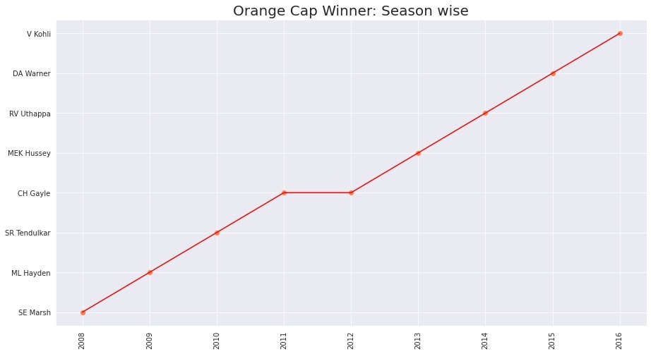
This graph shows the Orange Cap (given to player who scores most number of runs in a season) winner of the IPL each year and only CH Gayle was able to win it twice and made it possible in consecutive years.

Slide 16
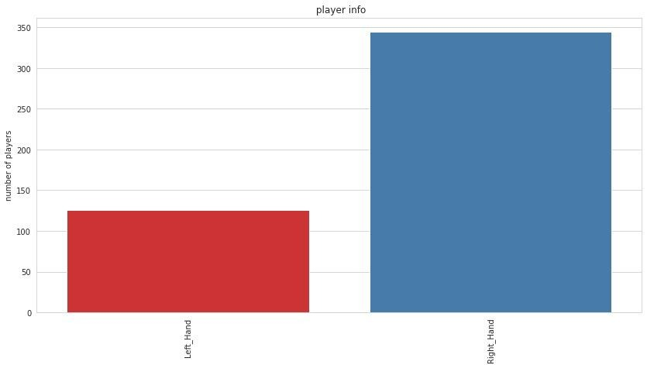
This graph shows an intriguing comparison between the number of left handed and right handed batsman who participated in IPL and it is evident that right handed batsman are larger compared to left handed batsman.

Slide 17
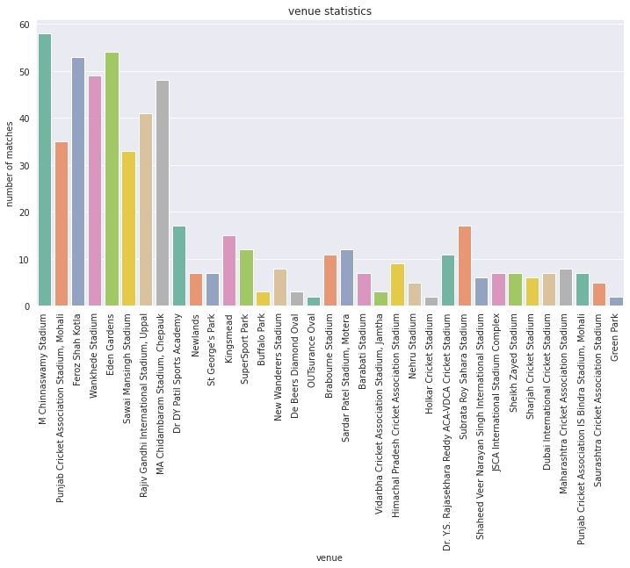
This graph depicts the number of matches played at each venue during the stint of IPL.

Slide 18
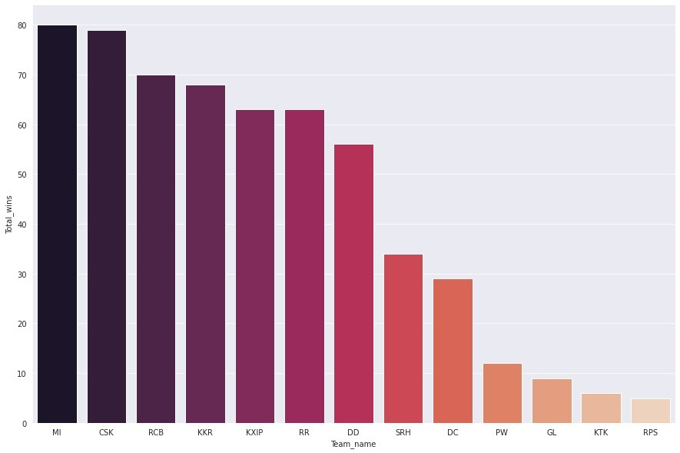
This graph displays the number of matches won by each franchise during the stint of IPL and don’t get deluded by this massive variation in number of matches won by franchises as some franchises participated only in one to two seasons.

Slide 19
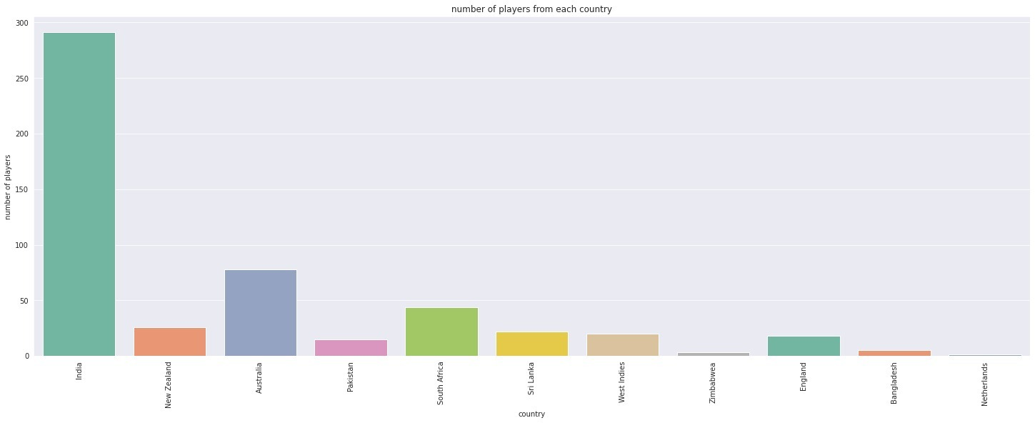
This graph portrays the total number of players from different countries to ever take part in IPL and the fact that more number of players are from India is undeniable because IPL is a tournament held to encourage young Indian players to perform at world stage.

Slide 20
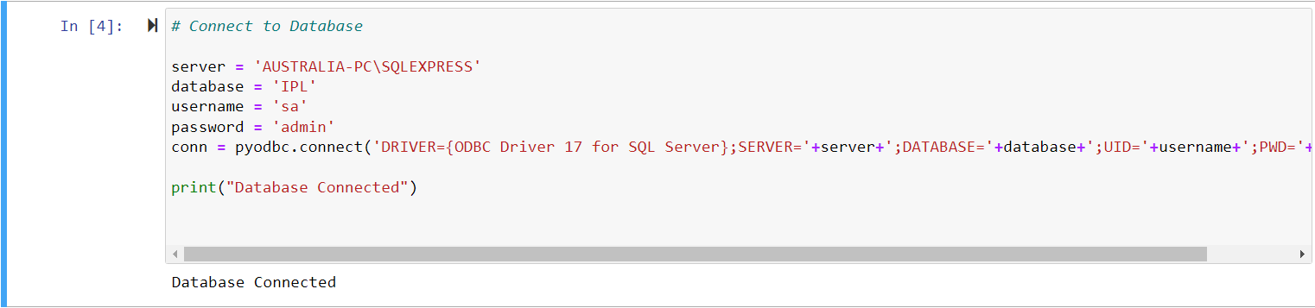
Creating and seeding the DB

Slide 21
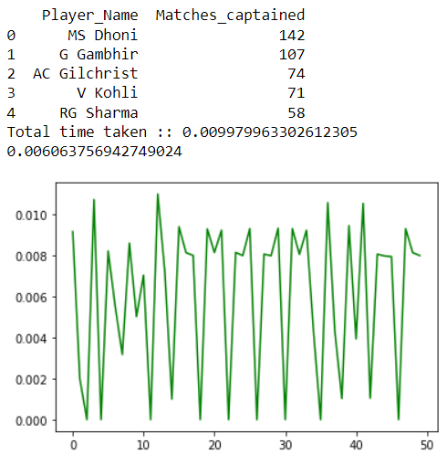
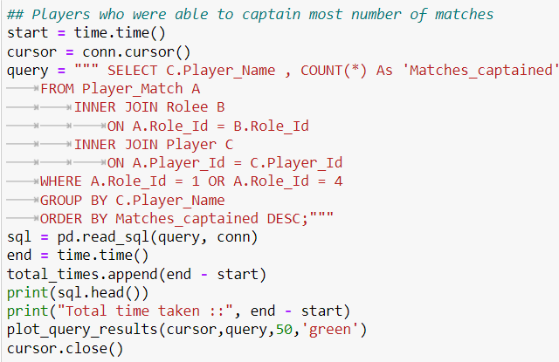
SQL QUERIES
Players who were able to captain most number of matches in IPL

Slide 22
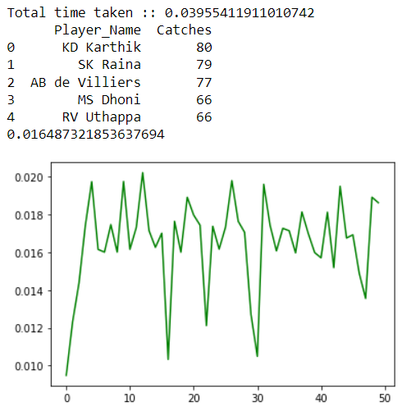
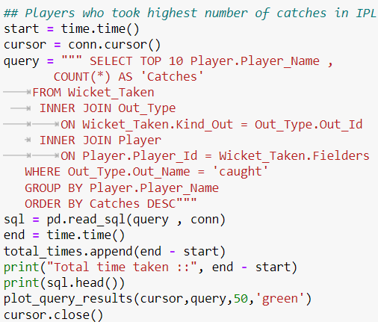
SQL QUERIES
Players who took highest number of catches in IPL

Slide 23
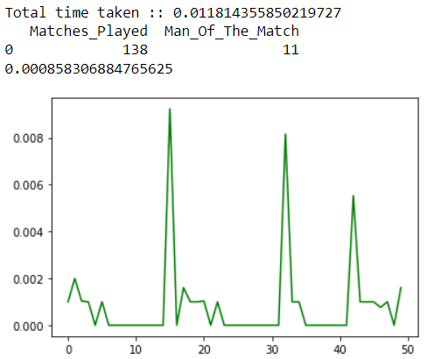
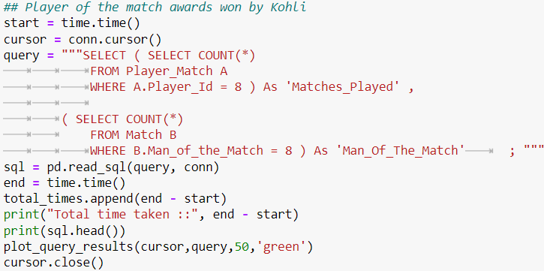
SQL QUERIES
Player of the match awards won by Kohli

Slide 24
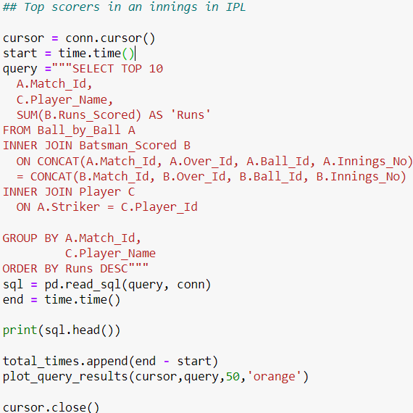
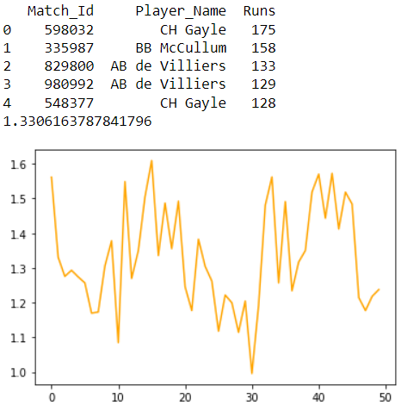
SQL QUERIES
Top scorers in an innings in IPL

Slide 25
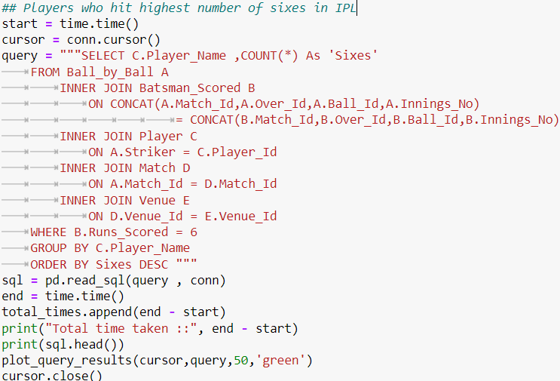
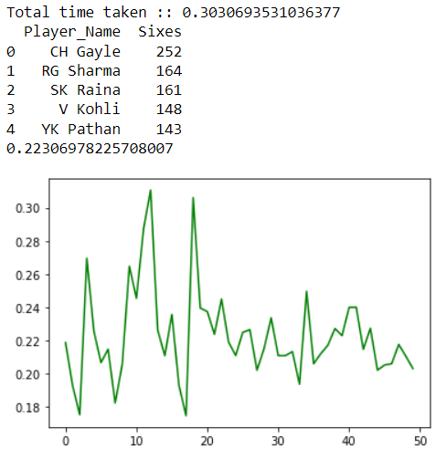
SQL QUERIES
Players who hit highest number of sixes in IPL

Slide 26
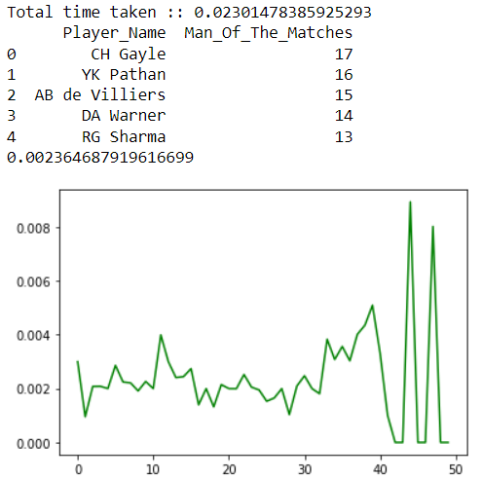
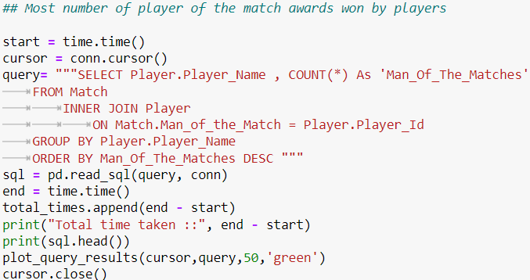
SQL QUERIES
Most number of player of the match awards won by players

Slide 27
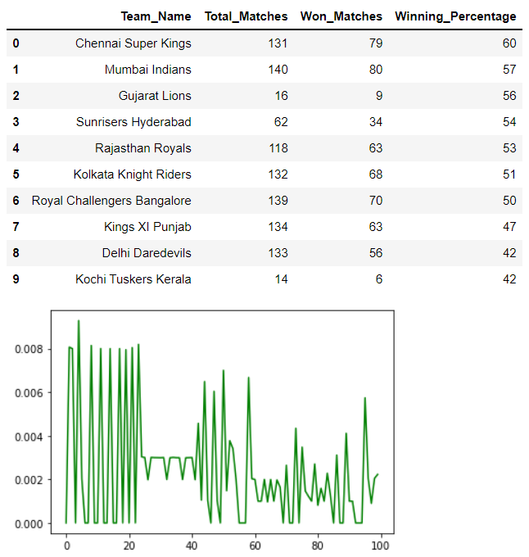
Here the result shows the no. of watches won by each IPL team along with its win percentage.

Slide 28
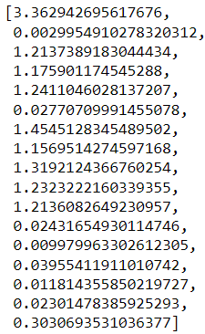
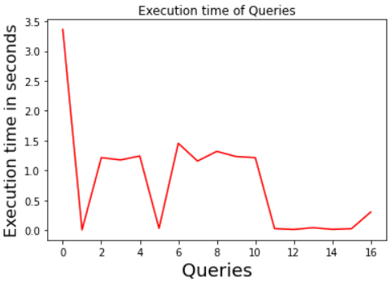
EXECUTION TIME OF QUERIES

Slide 29
CONCLUSION
Objectives achieved
a. We were able to implement working relational database and perform some insightful exploratory data analysis.
b. We were able to run queries and answer questions that might be of interest to users and were able to gain eminent practical experience while writing queries.
2) Challenges faced and lessons learned
a. Finalizing a Server after trying and failing for Postgres, Oracle and many more (Many other factors due to which some did not work and ultimately went for MS SQL).
b. While setting up connection with Python, issues like not able to identify the login and DB not found problems were solved.
c. Designing the queries, journey of getting errors and wrong results to Getting the desired Output.

Slide 30


